Slide 1
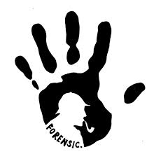
Image Forgery Analysis & Detection Using Image Processing For Forensic Sciences
Project Mentor :
Mrs. Sharmila Sengupta.
Group Members :
1. Jaya Kukreja.
2. Hiral Shah.
3. Prajakta Shinde.

Slide 2
Problem Definition
Images play an important role in forensics laboratory. With the ease of using image-processing tools, non-existing situations can be created and presented as evidence in a court of law. It is simple to manipulate and modify digital images without leaving any obvious traces of tampering. This diminishes the credibility of photographs as a definitive proof of events. For digital image to be used as evidence, image authentication is necessary. Digital image forensics is used for authenticating information available in images.
This project encompasses analysis of possible image forgeries and implementation of detection techniques for some of the forgeries.
Implementation involves:
Recognition
Splicing
Steganalysis
Copy-move forgery detection
Detection of deletion of an object

Slide 3
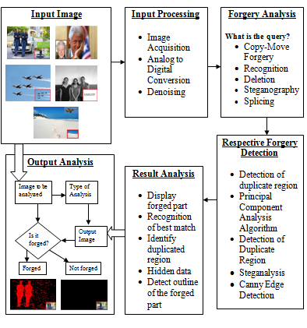
Block Diagram

Slide 4
Input processing
Image Acquisition:
Images are obtained directly from devices like camera, scanner, etc or media, newspapers, magazines, photographs.
Analog to Digital conversion:
For digital image processing, analog images are converted into digital images by analog to digital conversion.
Denoising:
Different filters like high-pass filters, low-pass filters, median filters are used for denoising of noises present in images like salt-and-pepper, Gaussian, quantization, shot noise, etc

Slide 5
Forgery Analysis
Questioned documents
Art forgery
Image forgery
Copy-Move Forgery or Cloning
JPEG Format Analysis
Double Quantization Effect
Error Level Analysis
Non-consistent Image Quality
Mixed images

Slide 6
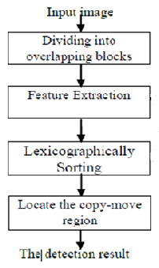
Copy-move forgery
A portion from the picture is copied and pasted over any other portion in the same image.
It is also called as cloning.

Slide 7
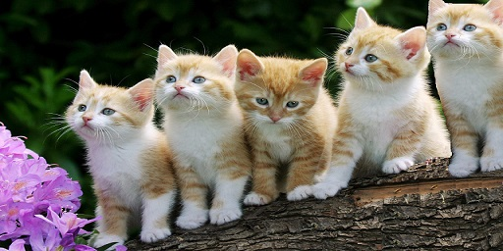
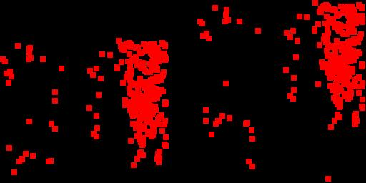
Examples:
Input Image:
Output:

Slide 8
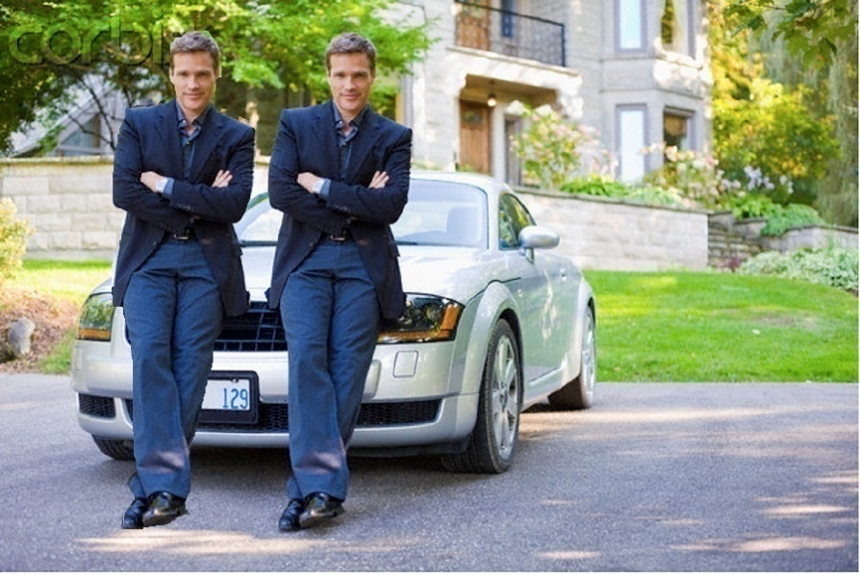
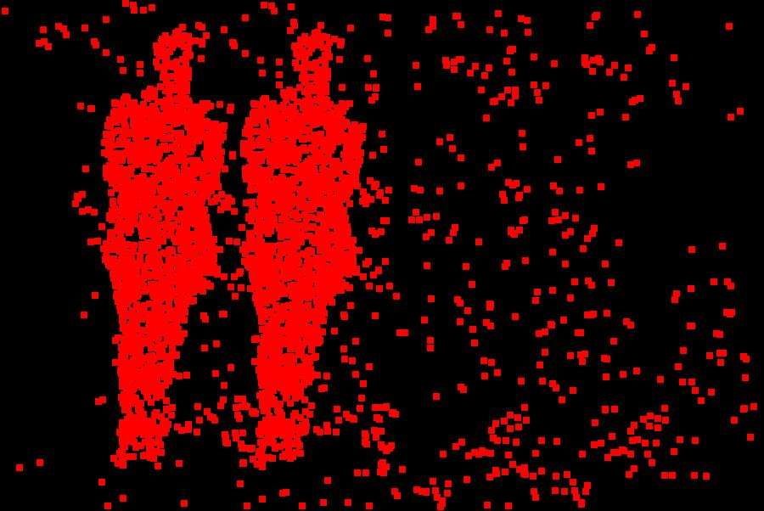
Input Image:
Output:

Slide 9
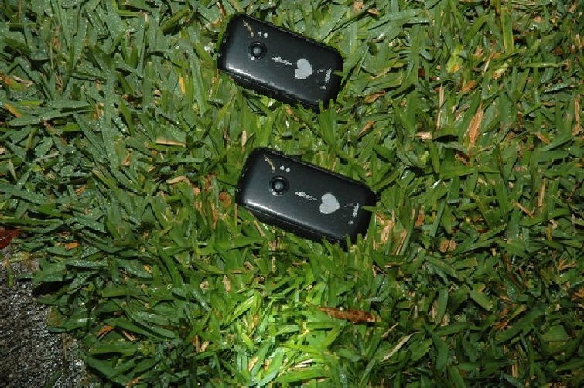
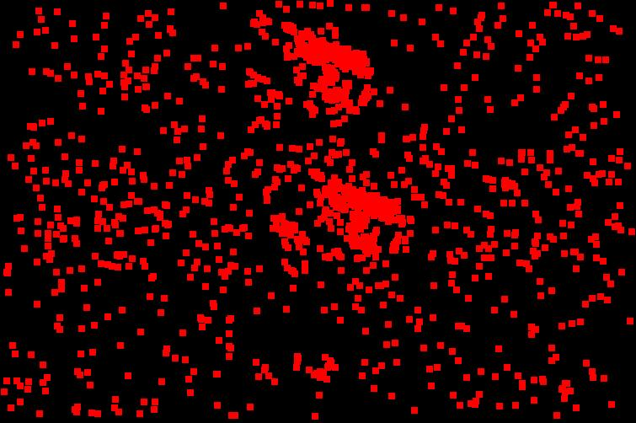
Input Image:
Output:

Slide 10
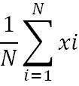
Recognition
PCA is one of the most important techniques in image recognition and feature extraction.
Denote column vectors xi ∈ Rn, i = 1, ..., N as the input data.
The overall mean is:
μ =
The zero-meaned data is packed into a n x N matrix :
M = ( x₁ - μ x2 - μ ….. xN - μ )
The n x n covariance matrix is computed as :
C = MM^{T}
The principle components are the eigenvectors ej of the covariance matrix (i.e., Cjej=λjej),where the eigenvalue, λj is proportional to the variance of the original data along the jth eigenvector.)

Slide 11
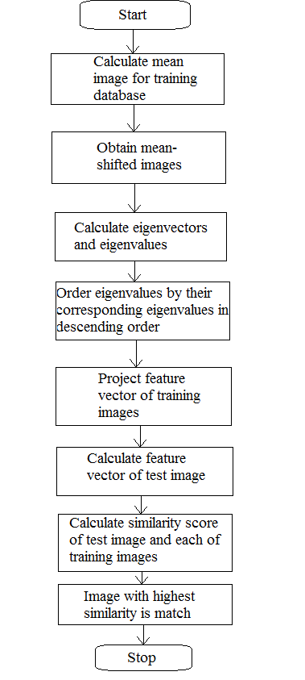
Algorithm:

Slide 12


Examples:
Input Image:
Output:
Front view of same flower
stored in database
Oriented view of flower to be tested

Slide 13

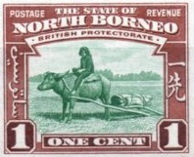
Input Image:
Output:
Image with stamp for testing
Image recognized after testing

Slide 14
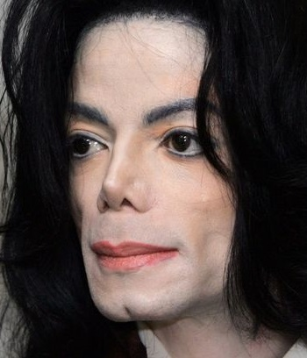
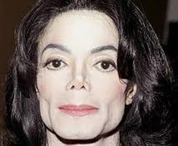
Input Image:
Output:
Image with slightly rotated face
for testing
Resulting image from database

Slide 15


Input Image:
Output:
Image with specks for testing
Resulting image from database

Slide 16


Input Image:
Output:
Image with accessories and
facemark for testing
Resulting image stored in
database

Slide 17
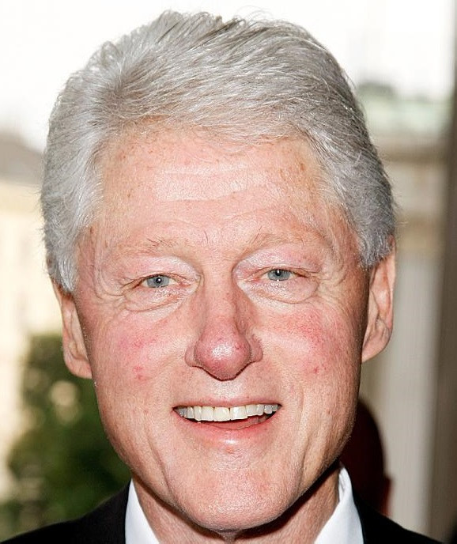
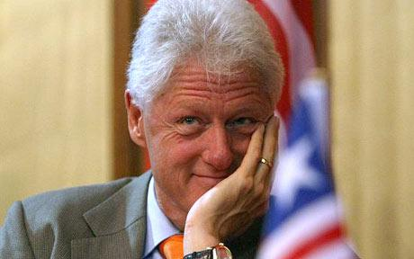
Input Image:
Output:
Image with different expression
for testing
Resulting image from database

Slide 18
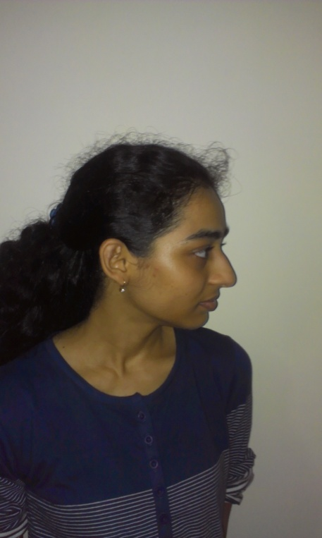
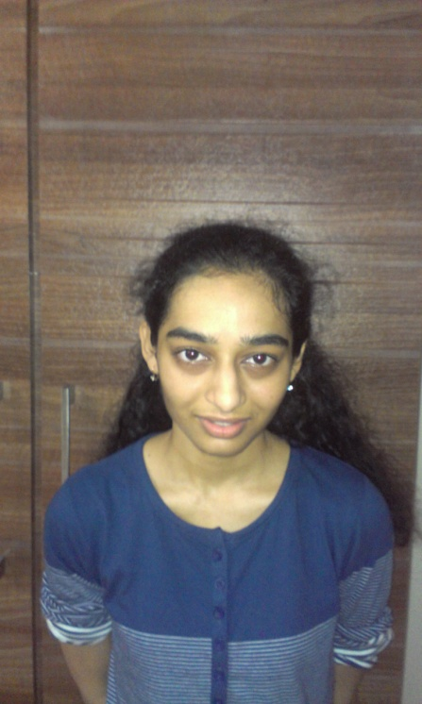
Input Image:
Output:
Image with tilted face for testing
Resulting image from database

Slide 19
Deletion of an Object Forgery
A portion from the picture is copied and pasted over any unwanted portion in the same image.

Slide 20
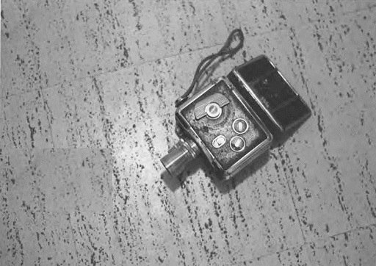
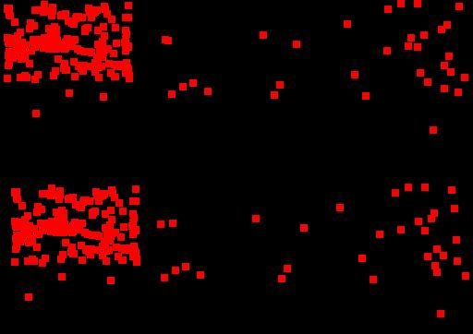
Examples:
Input Image:
Output:

Slide 21
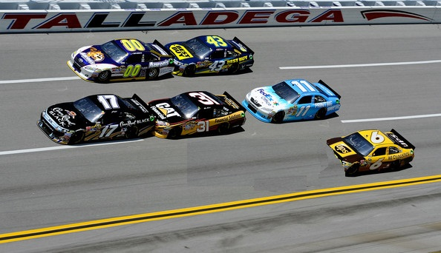
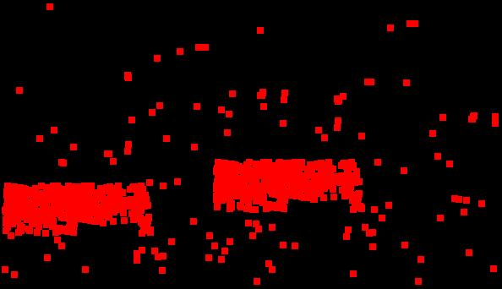
Input Image:
Output:

Slide 22
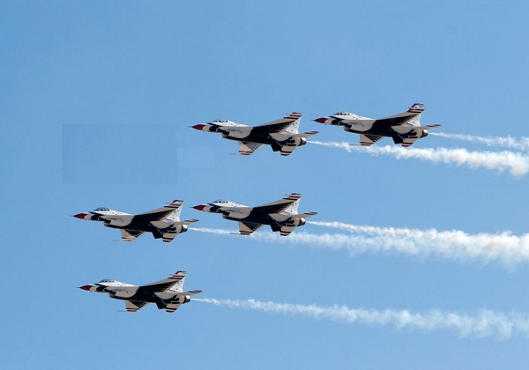
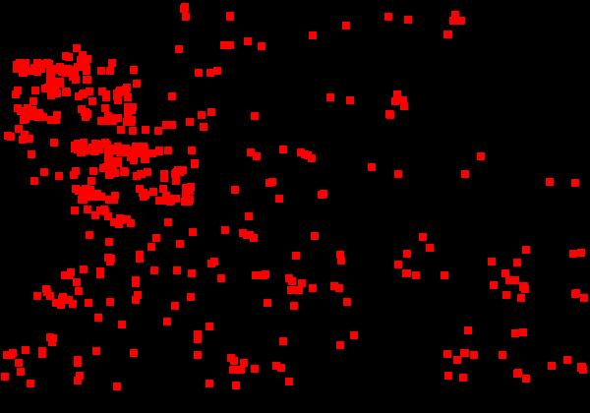
Input Image:
Output:

Slide 23
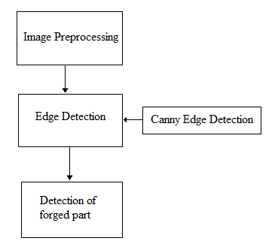
Splicing
It is a method of tampering images by combining two sources to produce a new image which retains the majority of one image for detail.

Slide 24
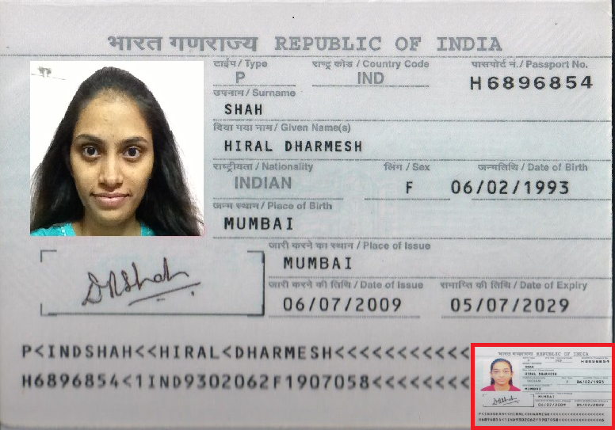
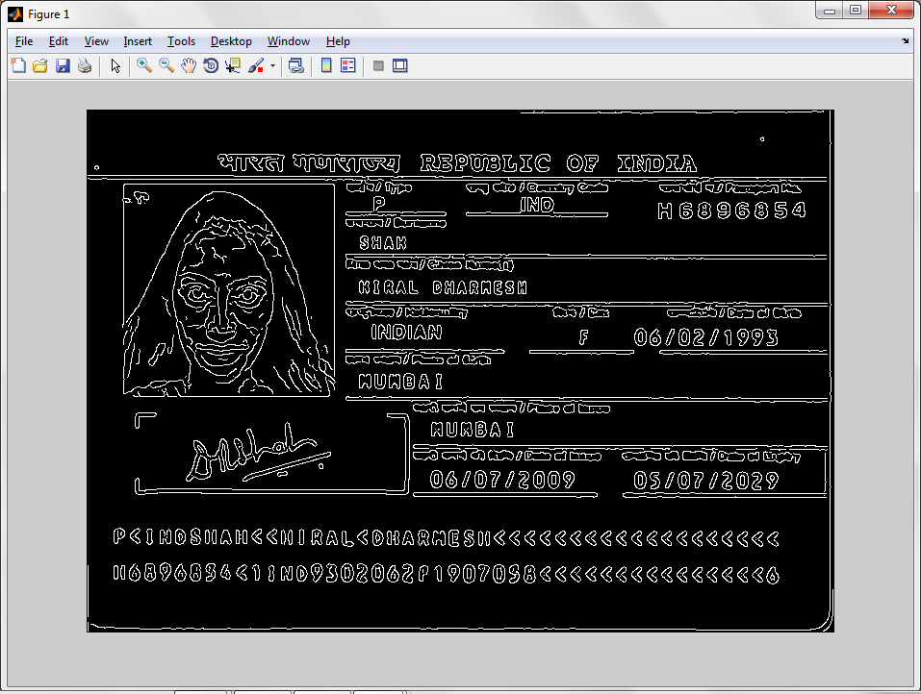
Exmaples:
Input Image:
Output:

Slide 25

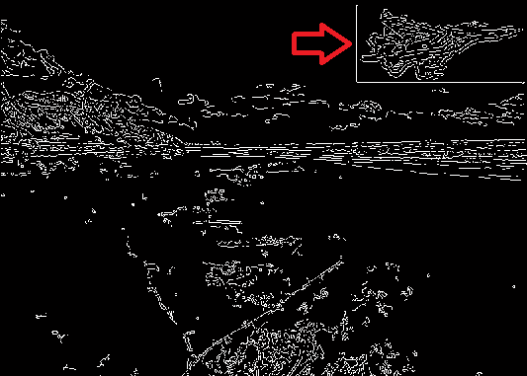
Input Image:
Output:

Slide 26


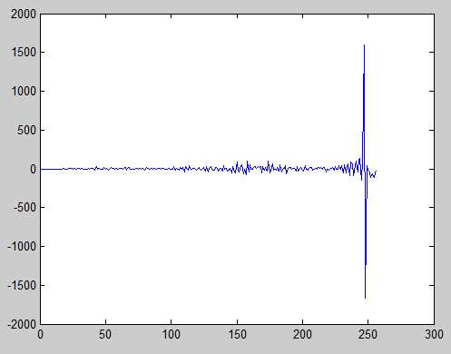
Double quantization effect
These two images look identical, although the second picture was opened in a graphic editor and then saved.
The following is the difference in their histograms:

Slide 27


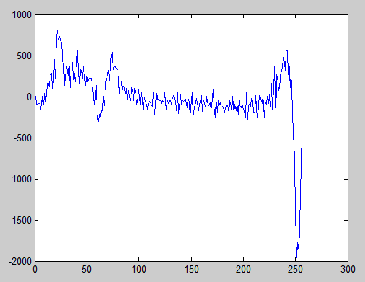
Double quantization effect
Original image and the second image is created by scaling the red rose as well as tilting by 180 degrees.
The following is the difference in their histograms:

Slide 28
Non-Consistent Image
JPEG is a lossy format.
Every time the same image is opened and saved in the JPEG format, some apparent visual quality is lost and some artifacts appear.
You can easily reproduce the issue by opening a JPEG file, saving it, closing, then opening and saving again. Repeat several times, and you’ll start noticing the difference; sooner if higher compression levels are specified.

Slide 29


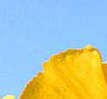
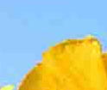
Example

Slide 30
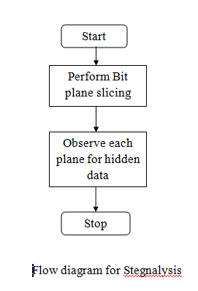
Steganography
Steganography is the science that involves communicating secret data in an appropriate multimedia carrier, e.g., image, audio, and video files.

Slide 31
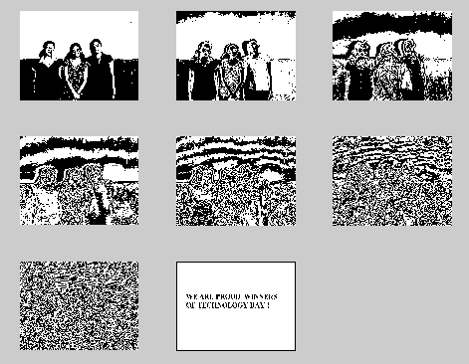
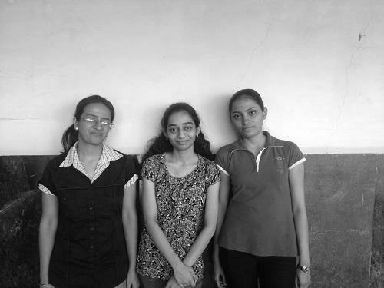
Examples:
Input Image:
Output:

Slide 32
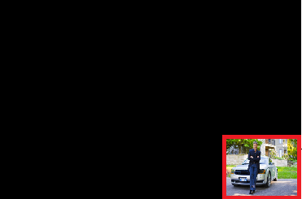
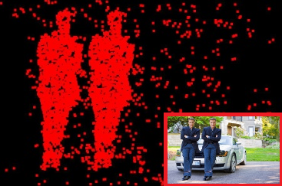
Result Analysis
Not forged :
Forged:

Slide 33
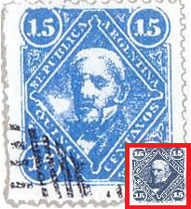
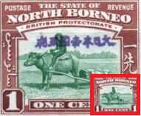
Not forged :
Forged:

Slide 34
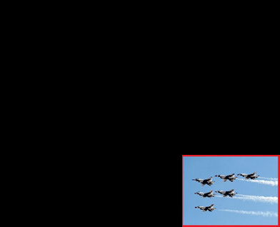
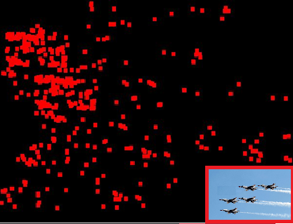
Not forged :
Forged:

Slide 35
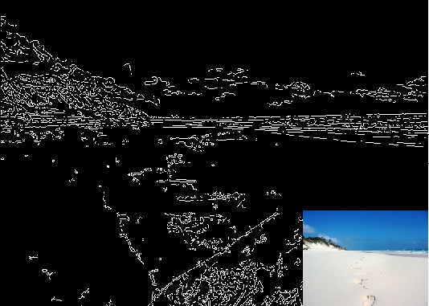
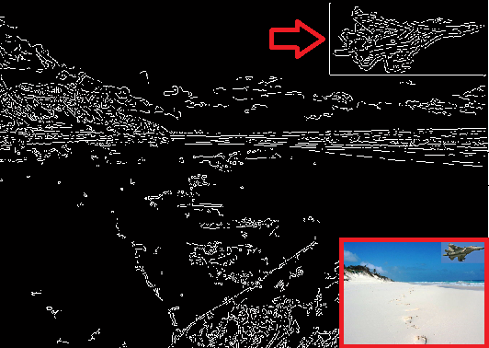
Not forged :
Forged:

Slide 36
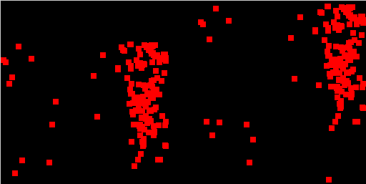
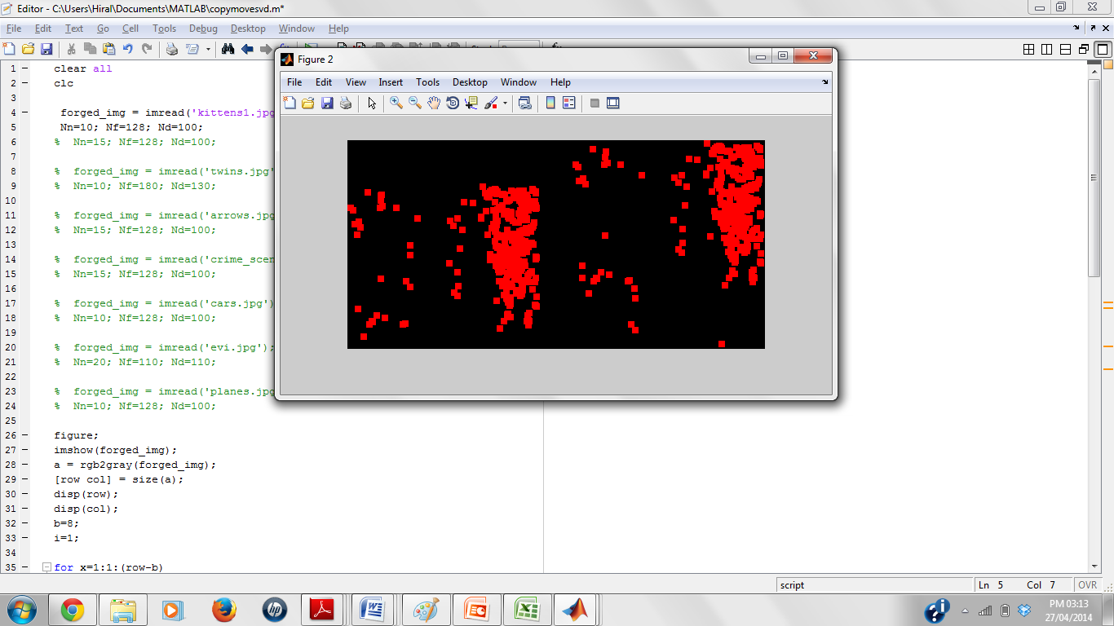
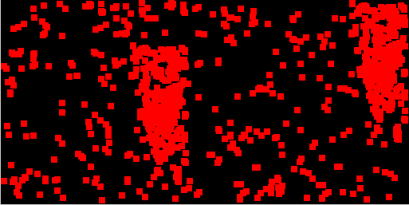
Copy Move Forgery & Deletion of an Object Detection
Effect of parameter Nn on output:
Original Image
Nn=10
Nn=15
Nn=17

Slide 38
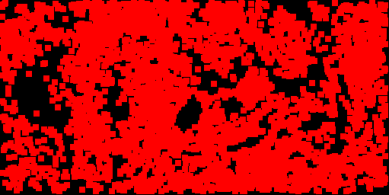
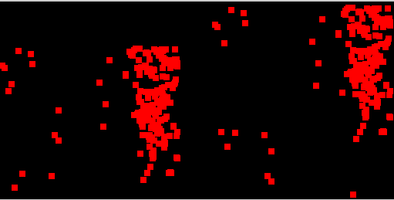
Effect of parameter Nn on output:
Original Image
Nf=100
Nf=128
Nf=200

Slide 40
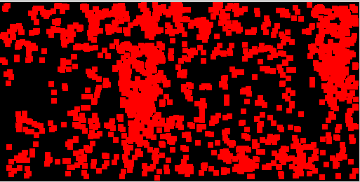

Effect of parameter Nd on output:
Original Image
Nd=75
Nd=100
Nd=300

Slide 42
Achivements
Published paper entitled “Retouching Detection and Steganalysis”, in IJEIR journal, Volume-2, Issue-6, November 2013.
Selected for presenting the project on Technology Day.
Paper accepted in IJECCE journal Volume-5, Issue-2, Mar. - April 2014.

Slide 43
Conclusion & future Scope
Most of the confidential forgery detection requires an Optical Laboratory which uses magnifiers, high-powered microscopes (micro and macro objectives), polarizers, complete spectral analyzers, including infrared, ultraviolet (short and long wave) and LASER fluorescence amplification technologies.
Using MATLAB, we have implemented few algorithms to detect some of the forgeries.
Advancement in image forgeries necessitates detection techniques that make use of artificial intelligent, expert system, common sense reasoning, and machine learning technologies from the perspective of simulating human thought.

